Slide 1

YATRI PATEL 21BCP002
DEVEN BARAIYA 21BCP003
DHRUVIL SHAH 21BCP012
HEMANG MEHTA 21BCP026
ADITYA JANI 21BCP030
DINKY UNADKAT 21BCP033
COMPREHENSIVE STOCK PORTFOLIO MANAGEMENT SYSTEM
A Powerful Tool for Investors of All Types

Slide 2
CONTENTS
Introduction and Vision
Objective
Our Approach
System Features
Model Applications
Output
Conclusion

Slide 3
The Comprehensive Stock Portfolio Management System is a web application that offers a wide range of features to cater to investors of all types, from beginners seeking to learn and grow to seasoned traders and long-term investors.
This system aims to provide a robust, efficient, and secure platform that can scale to meet the needs of a growing user base. By incorporating web scraping capabilities, the system can acquire up-to-the-minute market data, making it a valuable resource and tool in the rapidly changing landscape of the financial world.
Introduction and Vision

Slide 4




The Objectives
Designed to cater to a diverse range of users, including individual investors, financial professionals, educational institutions, and investment groups.
Stock Portfolio Management
Real time market trend analysis
Stock buying and selling
Future investment insights.

Slide 5

The use of Python and Local Storage as well as certain Machine Learning Models as the underlying technologies ensures a robust, efficient, and secure web application that can scale to meet the needs of a growing user base.
The incorporation of web scraping capabilities allows for the acquisition of up-to-the-minute market data, enhancing the website's utility in the rapidly changing landscape of the financial world.
Our Approach

Slide 6
System Features
Log in and sign up page
Interface after signing up
The features provide a versatile platform for users to manage their stock portfolios, analyze market trends, and make informed investment decisions.
Current trends of the stocks purchased by users
Buying and selling stocks and storing user progress.
Data visualization and future trend predictions.

Slide 7
Model Applications
The potential applications of this website span a wide range, from individual investors and financial professionals to educational institutions and investment groups.
These users can benefit from the platform's features, such as stock portfolio management, trading, education, and research, to navigate the complexities of financial markets and work towards their investment goals with confidence.

Slide 8

Output:

Slide 9
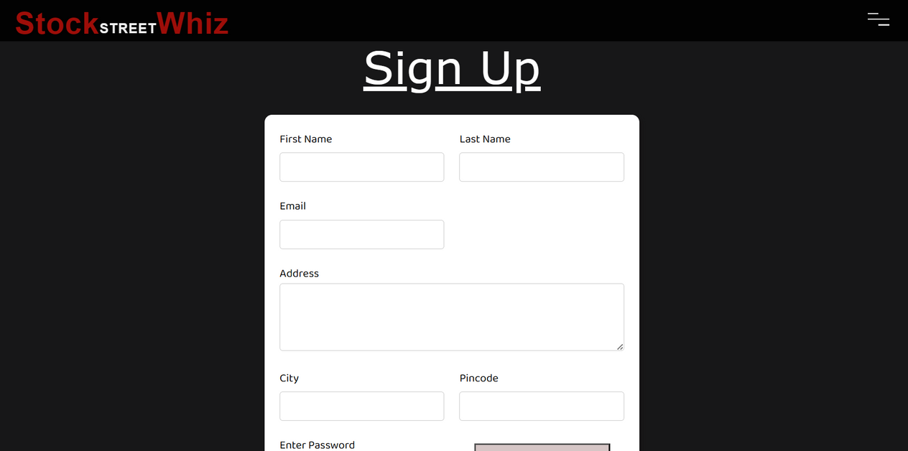
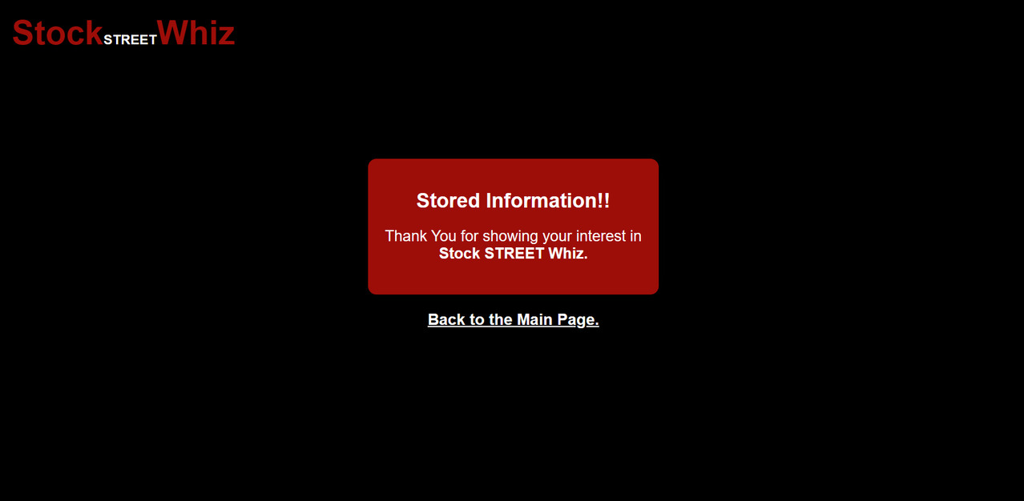
Output:

Slide 10
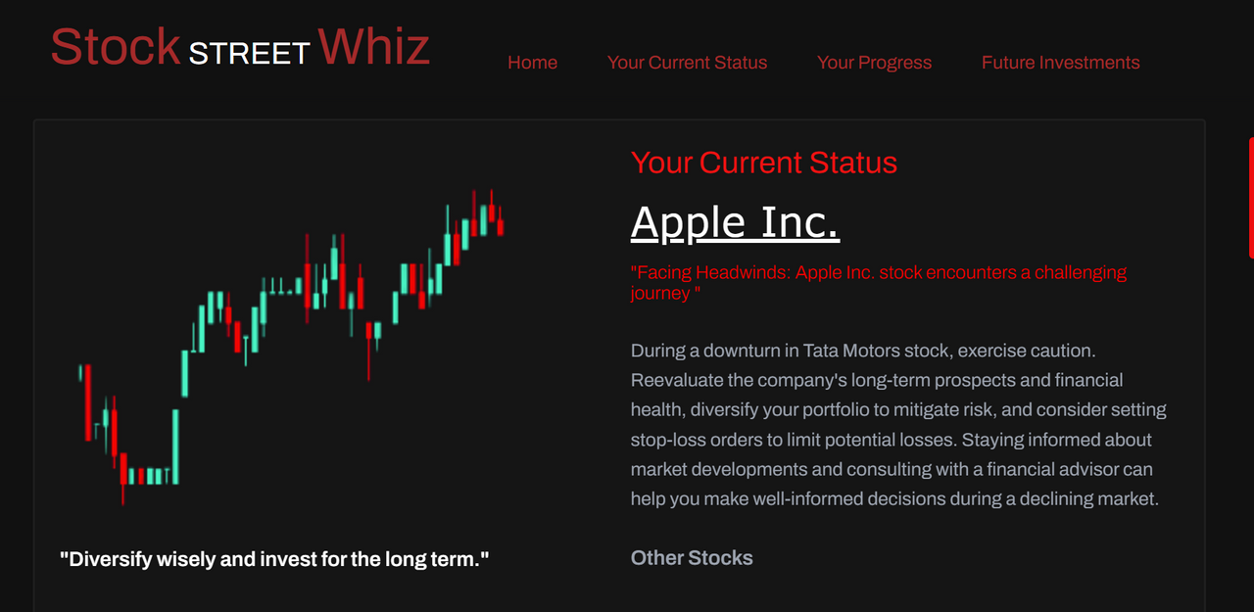
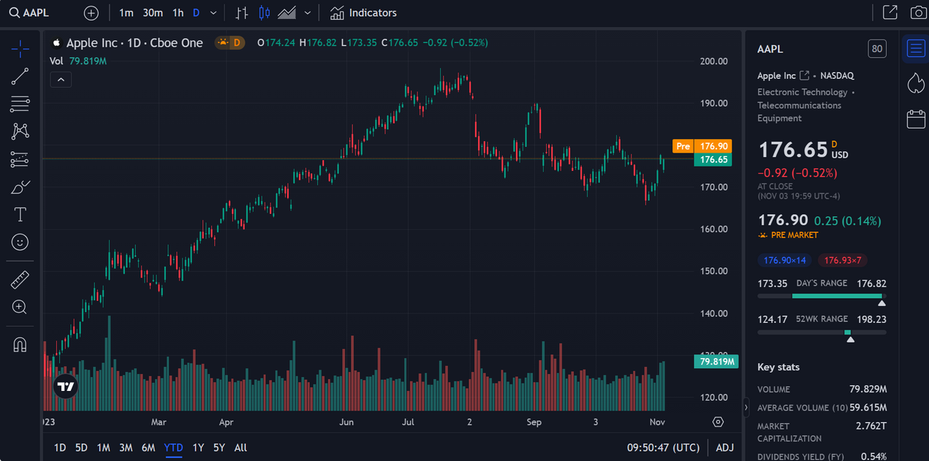
Output:

Slide 11
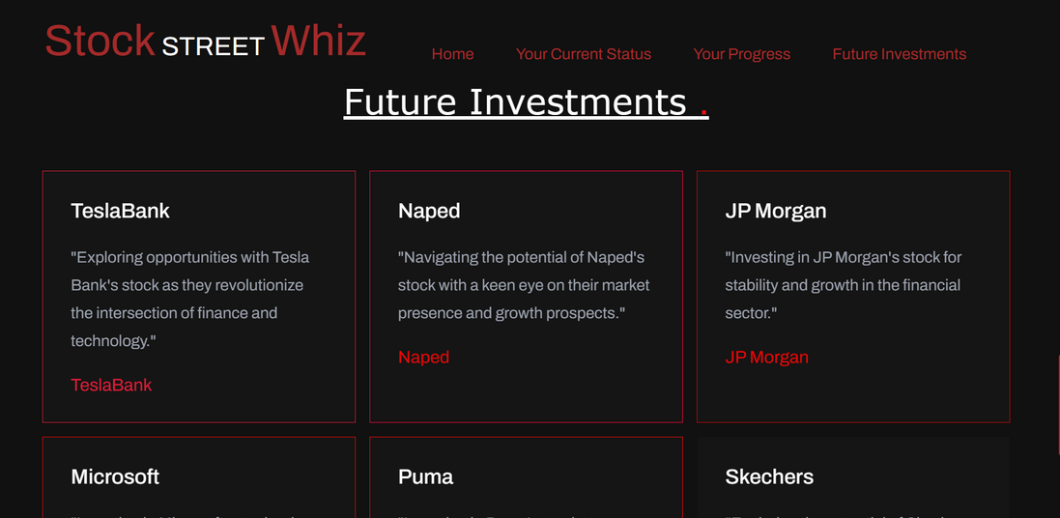
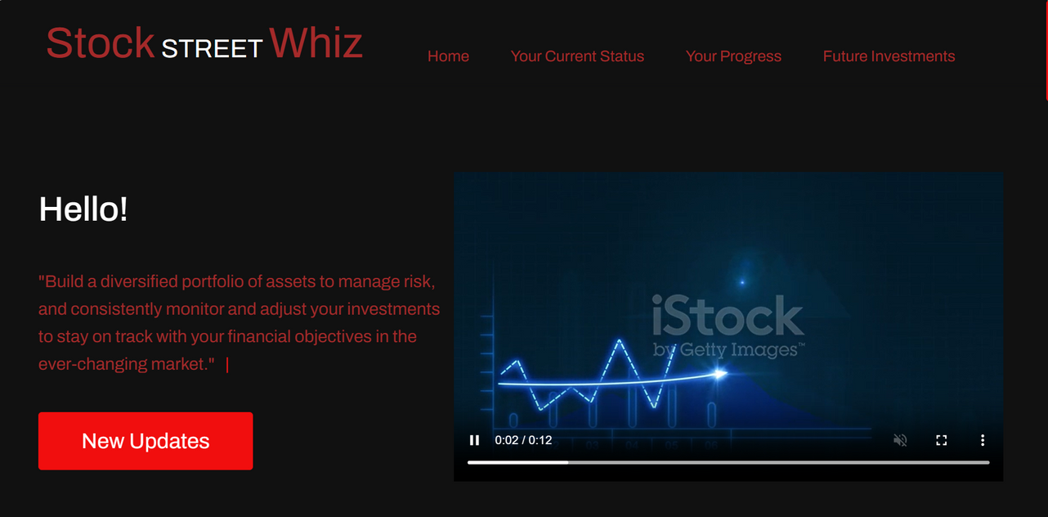
Output:

Slide 12
Conclusion
In a world where financial literacy and informed decision-making are more critical than ever, this website stands as a valuable resource and tool.
It helps users navigate the complexities of financial markets and work towards their investment goals with confidence.
As the financial landscape continues to evolve, this website remains poised to adapt, grow, and serve the needs of a dynamic and diverse user base.

Slide 13
THANK YOU!!

